Slide 1
Intro to CSS & the DOM
CS 130: Tools and Technologies of the World Wide Web
Spring, 2022

Slide 2
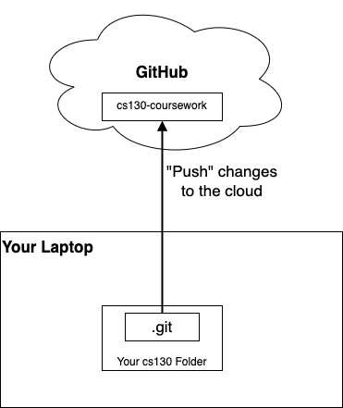
Announcements: Lab this Week: GitHub
Using GitHub, you’re going to publish your files to the cloud (someone else’s computer) so that other people can see your work!

Slide 3
Outline
The DOM
Intro to CSS
Selectors
The box model
Specificity and the cascade
Some common properties

Slide 4
Document Object Model (DOM)
(n.) a way of representing a document, like a web page, in a way that can be understood by a human and by a computer. Typically, a DOM is created using HTML. Declarative languages like CSS are used to style it, and programming languages like Javascript allow us to change it.
Notes:
Read Directly from slide…
Obvious, right?

Slide 5
Convert this Simple HTML Page to a DOM Diagram
<html lang="en"> <head> <title>DOM Example</title> <meta name="author" content="EECS 130"> <link rel="stylesheet" href="main.css"> </head> <body> <main> <h1>Hello!</h1> <p>Welcome to this webpage.</p> </main> </body> </html>

Slide 6
HTML Tree Diagram
<html>
<head>
<body>
<title>
<meta>
<link>
<main>
<h1>
<p>
Hello!
Welcome to this webpage.

Slide 7
DOM Schema
HTML
<html lang="en"> <head> <title>DOM Example</title> <meta name="author" content="EECS 130"> <link rel="stylesheet" href="main.css"> </head> <body> <main> <h1>Hello!</h1> <p>Welcome to this webpage.</p> </main> </body> </html>
<html>
<head>
<body>
<title>
<meta>
<link>
<main>
<h1>
<p>
Hello!
Welcome to this webpage.

Slide 8
The DOM (Document Object Model)
A way to manipulate elements and styles on a web page using CSS and JavaScript
Open your console and type:
> document

Slide 9
Outline
The DOM
Intro to CSS
Selectors
The box model
Specificity and the cascade
Some common properties

Slide 10

But how do you make stuff look nice?

Slide 11
CSS Files: Style & Layout
Controls the page style & layout
Stylesheets can either be internal (within style tags) or external (in a separate *.css file)
You can include as many stylesheets as you want!

Slide 12
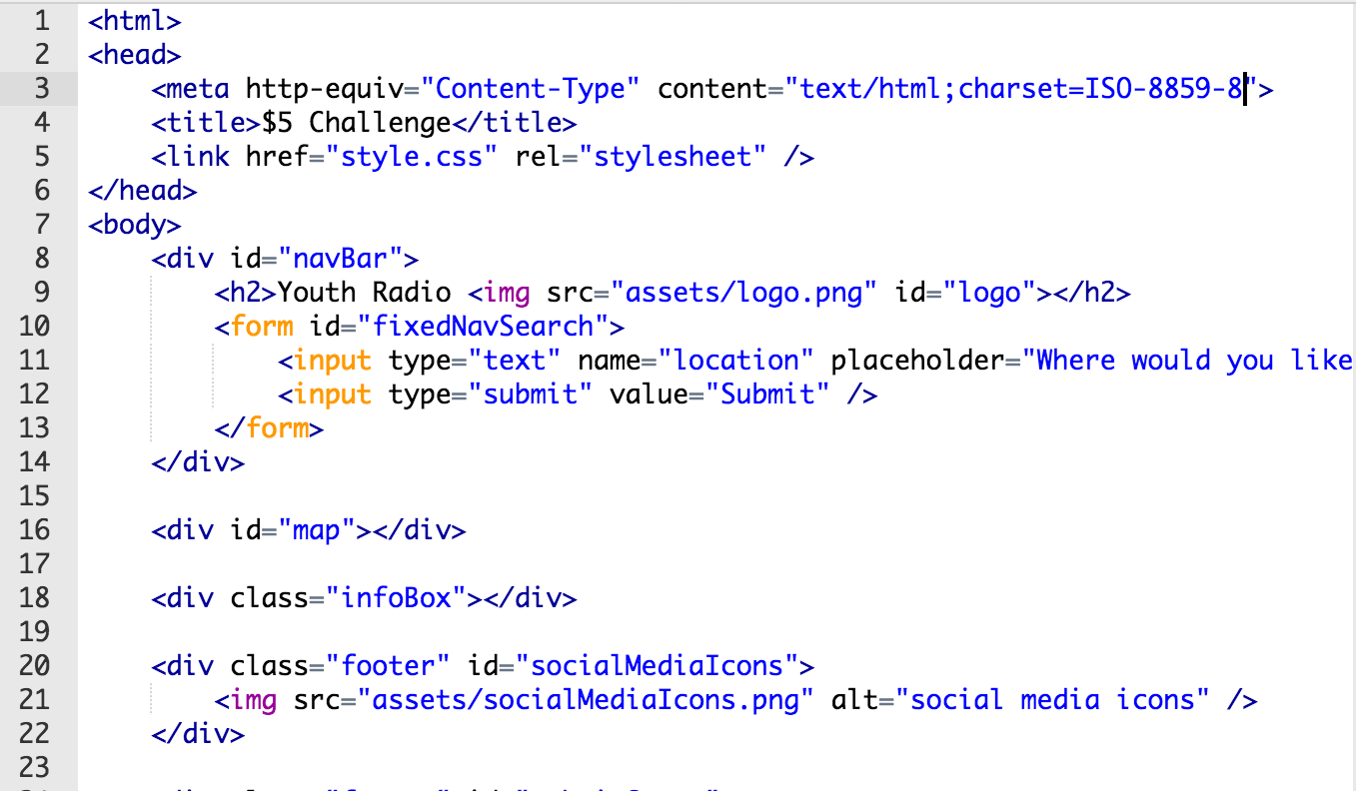
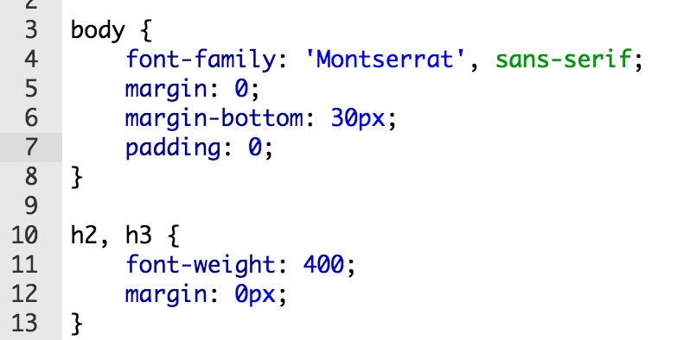
How to include a stylesheet in your HTML
External stylesheets are stored in a separate *.css

Slide 13
Anatomy of a Stylesheet
body {
color: black;
padding: 1em;
}
.title-bar {
padding: 5px;
font-weight: bold;
}
#profile {
background-color: #ddd;
}
Stylesheets are comprised of rulesets

Slide 14
Anatomy of a Ruleset
body {
color: black;
padding: 1em;
}
selector
property
value
declaration
Notes:
Selector- where you want to select the style
Property- what do you actually want to change

Slide 15
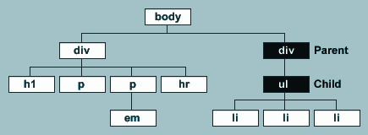
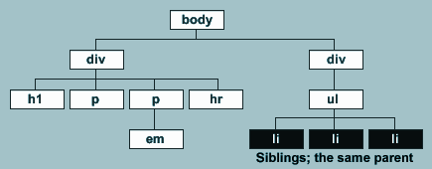
Relationships
1 <html>
2 <head><title>Hello!</title></head>
3 <body>
4 <div>
5 <h1>Left</h1>
6 <p>hi!</p>
7 <p><em>hello</em></p>
8 <hr>
9 </div>
10 <div>Right
11 <ul>
12 <li>list item 1</li>
13 <li>list item 2</li>
14 <li>list item 3</li>
15 </ul>
16 </div>
17 </body> 18 </html>
Parent & Child
Siblings
Notes:
Parent – the thing that contains the child

Slide 16
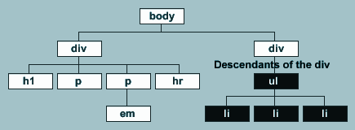
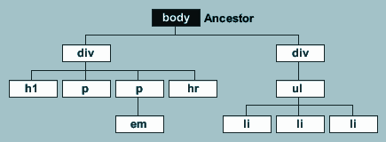
Relationships
1 <html>
2 <head><title>Hello!</title></head>
3 <body>
4 <div>
5 <h1>Left</h1>
6 <p>hi!</p>
7 <p><em>hello</em></p>
8 <hr>
9 </div>
10 <div>Right
11 <ul>
12 <li>list item 1</li>
13 <li>list item 2</li>
14 <li>list item 3</li>
15 </ul>
16 </div>
17 </body> 18 </html>
Descendants
Ancestors

Slide 17
Outline
The DOM
Intro to CSS
Selectors
The box model
Specificity and the cascade
Some common properties

Slide 18
Selectors: Most Important Ones
Selector | Example | Description
.class | .intro | Selects all elements with class=”intro”
#id | #firstname | Selects the element with id=”firstname”
* | * | Selects all elements
element | p | Selects all <p> elements
MEMORIZE THIS SLIDE

Slide 19
Selectors: Also Useful
Selector | Example | Description
element, element | div, p | Selects all <div> elements and all <p> elements
element element | div p | Selects all <p> elements inside <div> elements
element > element | div > p | Selects all <p> elements where the parent is a <div> element
element + element | div + p | Selects all <p> elements that are placed immediately after <div> elements
element~element | p ~ ul | Selects every <ul> element that is preceded by a <p> element

Slide 20
Selectors & Cascades
body {
color: grey;
}
h1, li {
text-transform: uppercase;
display: inline-block;
color: #999999;
}
.title-bar {
padding: 5px;
background-color: #EEEEEE;
}
#profile {
width: 100px;
float: left;
margin-right: 20px;
}
...
1 <body>
2 <div class=”title-bar”>
3 <h1>Welcome, Malik</h1>
4 <img id=”profile” src=”images/pic.png” />
5 <hr>
6 </div>
7 <div>Right
8 <ul>
9 <li>list item 1</li>
10 <li>list item 2</li>
11 <li>list item 3</li>
12 </ul>
13 </div>
14 </body>
...
Notes:
#profile – id selector

Slide 21
More Selectors & Cascades
...
1 <body>
2 <div class=”title-bar”>
3 <h1>Welcome, Malik</h1>
4 <section>
5 <p>text text text</p>
6 </section>
7 <p>123 456 789</p>
8 </div>
9 <p>blah blah blah</p>
10 <div>Right
11 <p>abc def ghi jkl</p>
12 </div>
13 </body>
...
div p {
color: red;
}
div > p {
color: red;
}
.title-bar p {
color: red;
}
Notes:
div p ---- the space p means go find all the ps
div > p --- the direct child of p (line 7 and 11)
.title-bar p (line 5 and 7)

Slide 22
More Selector Practice
https://eecs130.github.io/spring2021/css-reference/selectors/

Slide 23
1. Which are the selectors?
h1 {
color: blue;
margin-top: 1em;
}
.title-bar {
padding: 5px;
font-weight: bold;
}
#profile {
background-color: #ddd;
}

Slide 24
3. Name three properties
h1 {
color: blue;
margin-top: 1em;
}
.title-bar {
padding: 5px;
font-weight: bold;
}
#profile {
background-color: #ddd;
}
Notes:
Color
Margin
font

Slide 25
4. What will this rule set do to the HTML?
img {
width: 200px;
}
...
1 <body>
2 <div class=”nav-bar”>
3 <h1>Welcome, Malik</h1>
4 <section>
5 <p>text text text</p>
6 </section>
7 <img src=”pic1.png” />
8 <span>123 456 789</span>
9 </div>
10 <img src=”pic2.png” />
11 <p>blah blah blah</p>
12 <div>
13 <p>abc def ghi jkl</p>
14 </div>
...
Notes:
Left -- Find any image anywhere

Slide 26
5. What will these rule sets do to the HTML?
body {
text-transform: uppercase;
}
div img {
border: solid 2px #F00;
}
...
1 <body>
2 <div class=”nav-bar”>
3 <h1>Welcome, Malik</h1>
4 <section>
5 <p>text text text</p>
6 </section>
7 <img src=”pic1.png” />
8 <span>123 456 789</span>
9 </div>
10 <img src=”pic2.png” />
11 <p>blah blah blah</p>
12 <div>
13 <p>abc def ghi jkl</p>
14 </div>
...
Notes:
Div img (line 7)

Slide 27
6. What will this rule set do to the HTML?
* {
color: red;
text-transform: uppercase;
}
...
1 <body>
2 <div class=”nav-bar”>
3 <h1>Welcome, Malik</h1>
4 <section>
5 <p>text text text</p>
6 </section>
7 <img src=”pic1.png” />
8 <span>123 456 789</span>
9 </div>
10 <img src=”pic2.png” />
11 <p>blah blah blah</p>
12 <div>
13 <p>abc def ghi jkl</p>
14 </div>
15 <button>Click me</button>
...

Slide 28
7. What will this rule set do to the HTML?
h1, span {
color: red;
text-transform: uppercase;
}
...
1 <body>
2 <div class=”nav-bar”>
3 <h1>Welcome, Malik</h1>
4 <section>
5 <p>text text text</p>
6 </section>
7 <img src=”pic1.png” />
8 <span>123 456 789</span>
9 </div>
10 <img src=”pic2.png” />
11 <p>blah blah blah</p>
12 <div>
13 <p>abc def ghi jkl</p>
14 </div>
15 <button>Click me</button>
...
Notes:
1 and span (line 3 and 8)

Slide 29
Outline
The DOM
Intro to CSS
Selectors
The box model
Specificity and the cascade
Some common properties

Slide 30
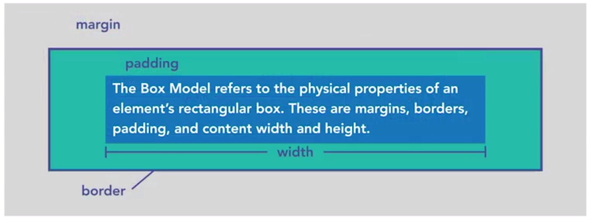
The Box Model
References:
W3 Schools
Lynda.com Video

Slide 31
The Box Model
margin
padding
border
width
box-sizing (border-box v. content box)
display (block, inline-block, inline, grid, none, etc.)
https://codepen.io/vanwars/pen/WWRqRY?editors=0100

Slide 32
Block-Level Elements
<address> <article> <aside> <blockquote> <canvas> <dd> <div> <dl> <dt> <fieldset> <figcaption> <figure> <footer> <form> <h1>-<h6> <header> <hr> <li> <main> <nav> <noscript> <ol> <p> <pre> <section> <table> <tfoot> <ul> <video>
https://codepen.io/vanwars/pen/WWRqRY?editors=0100

Slide 33
Inline Elements
<a> <abbr> <acronym> <b> <bdo> <big> <br> <button> <cite> <code> <dfn> <em> <i> <img> <input> <kbd> <label> <map> <object> <output> <q> <samp> <script> <select> <small> <span> <strong> <sub> <sup> <textarea> <time> <tt> <var>
https://codepen.io/vanwars/pen/WWRqRY?editors=0100

Slide 34
Outline
The DOM
Intro to CSS
Selectors
The box model
Specificity and the cascade
Some common properties

Slide 35
Specificity and the Cascade
The “cascade” refers to the way that CSS styles are applied to HTML elements. Styles applied to elements cascade down to their descendants, unless they are overridden.
Specificity is the means by which browsers decide which CSS property values are the most relevant to an element and, therefore, will be applied.
You can think of the cascade as a layering of styling rules, in order of specificity.

Slide 36
Specificity and the Cascade
More specific style declarations take precedence over more “distant” ones:
If one rule is more specific than another one, the more specific rule wins.
If two rules share the same specificity, then then the more “recent” rule takes precedence.
Note: Some properties are not inherited (because it wouldn’t make sense if they did). A table of properties that are / are not inherited can be found at the W3C specification site.
Notes:
Class rule is more

Slide 37
Outline
The DOM
Intro to CSS
Selectors
The box model
Specificity and the cascade
Some common properties

Slide 38
Common CSS Properties and Techniques
Fonts
Color
Box Model (border, margin, padding, width, height)
pseudo-classes (:hover, :active, :visited, etc.)

Slide 39
Activity
CSS Practice

